Slide 1
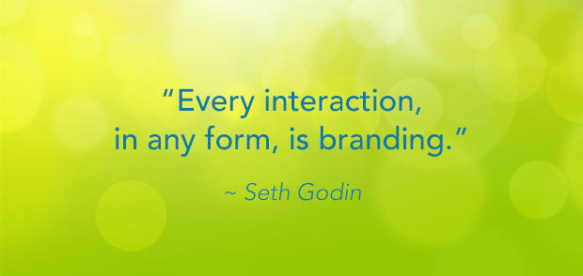

Slide 2

Brand Building and Special Purpose Advertising
By Krishnan R
SIES (Autonomous), Sion West

Slide 3




Brand kya hota hai?
A brand is a name, term, design, symbol, or other feature that distinguishes an organization or product from its rivals in the eyes of the customer.
Brands are used in business, marketing, and advertising.
Brands are mainly distinguished from generic goods.

Slide 4
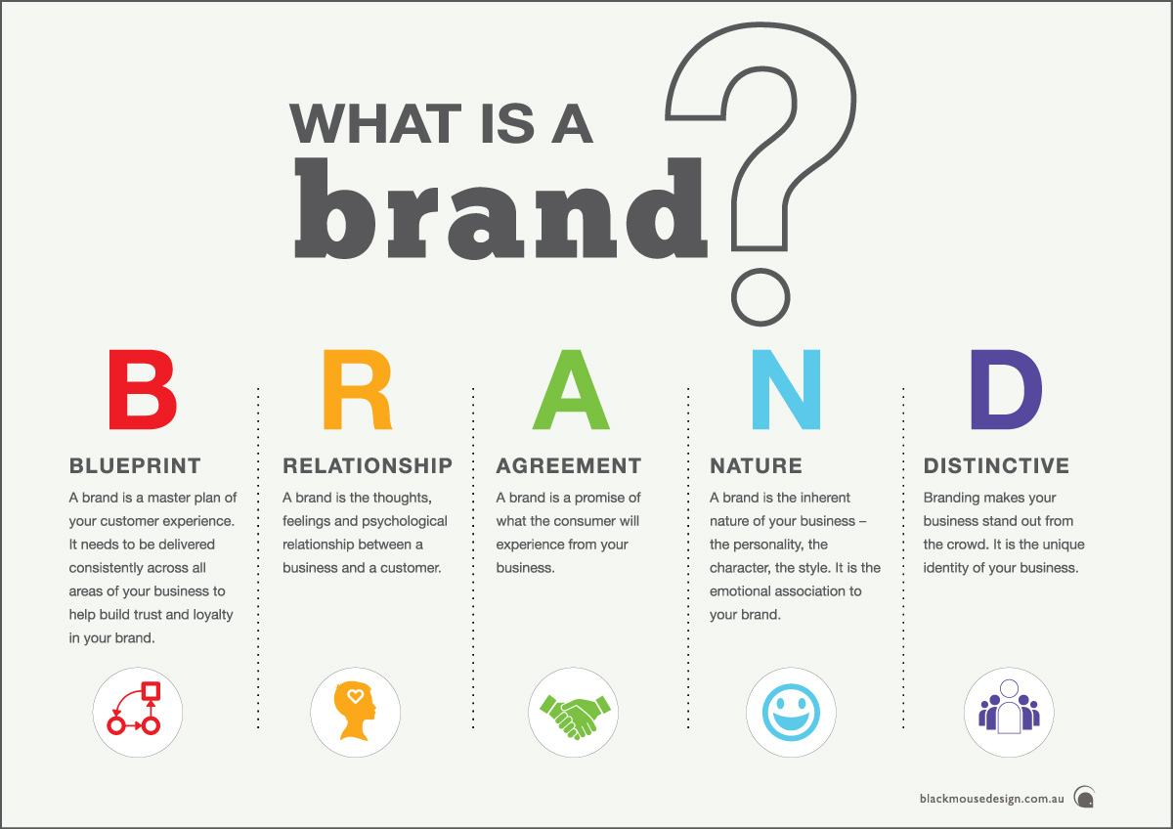

Slide 5


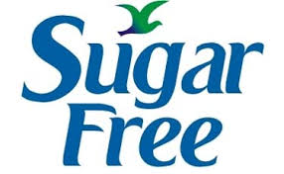









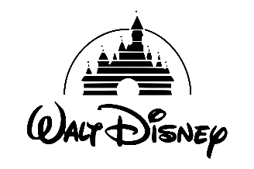

Brand Types
Disruptive Brand — Challenges the current ways of doing things and introduces new concepts that substantively change the market
Conscious Brand — Is on a mission to make a positive social or environmental impact or enhance people’s quality of life
Service Brand — Consistently delivers high-quality customer care and service
Innovative Brand — Consistently introduces advanced and breakthrough products and technologies
Value Brand — Offers lower prices for basic quality
Performance Brand — Offers products that deliver superior performance and dependability
Luxury Brand — Offers higher quality at higher price
Style Brand — Is differentiated through the way its products or services look and feel, as much as or more than what they do
Experience Brand — Is differentiated through the experience it provides, as much as or more than the product or service

Slide 6
AIDA Model
A - Attention
I - Interest
D - Desire
A- Action

Slide 7

A - Attracting Attention
Attractive Headline, Illustration, Cartoon, Scenery, Background, Personalities, Motion, Colour Combination, Contrast, Size, Blank Space, Layout, etc.
I - Arousing Interest
Through buying motives such as love and affection, pride and possession, comfort and convenience, sex and romance, special features, utility, price, distribution, brand, etc.
D - Creating Desire
Through product features, positive effects, performance/demonstration, after sale services, promo offers, testimonials and reviews, goodwill and image.
A - Securing Action
Actual Conversion. Provision of instructions, limited availability, immediate benefits, etc.

Slide 8
Role of Advertising in Developing Brand Image
Advertising Factors
Creativity
Ambassadors
Media Selection and Scheduling
Symbols
Sponsorships
Size of the Ad
Humour
Non - Advertising Factors
Promotional Offers
Supply Chain
After Sale Service
Product Performance
Product Price
Corporate Image
Packaging Style

Slide 9
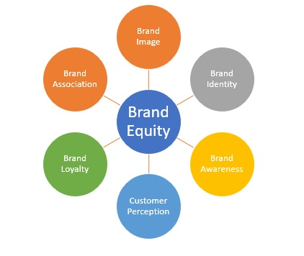
Brand Equity
Positive
Negative

Slide 10
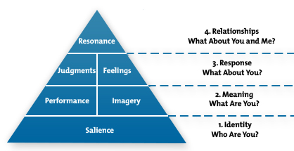
How to establish Brand Equity?

Slide 11


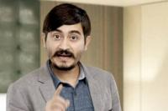

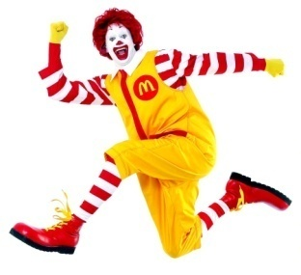
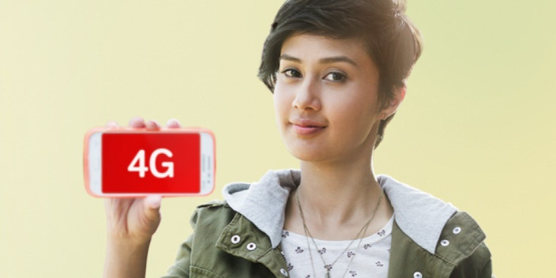

Factors Influencing Brand Equity
1. Brand Loyalty
2. Brand Awarensss
3. Customer Perspection about the Brand
4. Brand Associations
5. After Sale Services
6. Brand Ambassadors
7. Brand Mascot
8. Brand Protection
9. Brand Logo and Tag Line

Slide 12
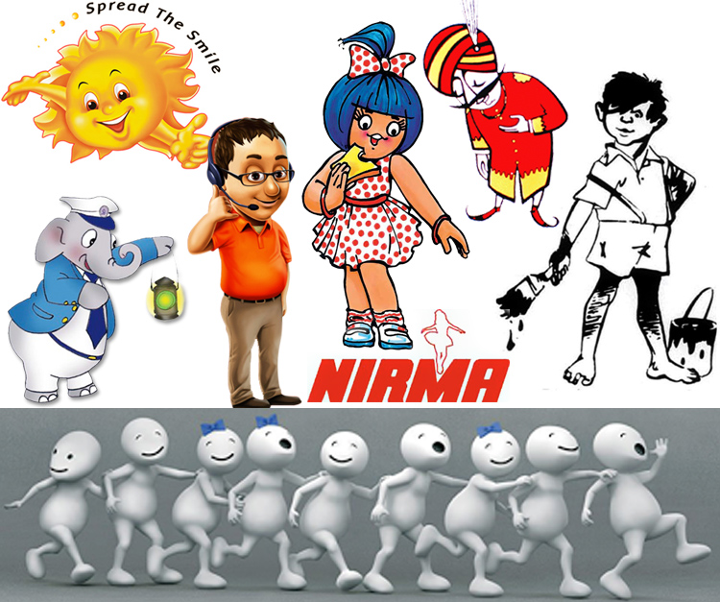
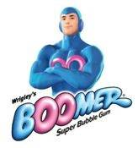
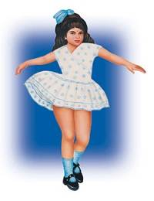
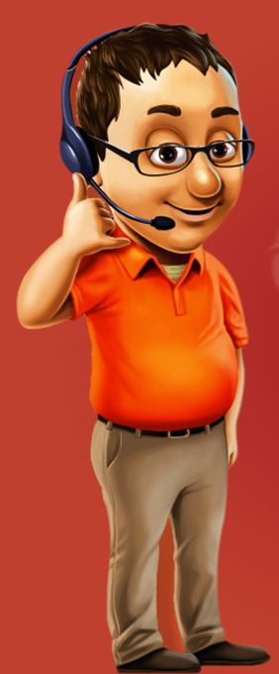
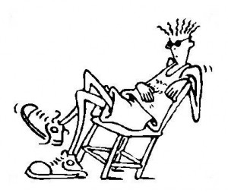
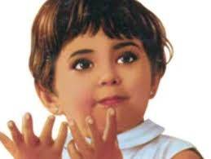

Slide 13
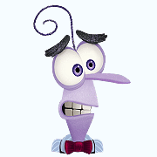

Brand Crisis
Negative Brand Equity
Loss of brand value
Impacts Corporate Image
Can mount up penalties and fines for the Company
Affects market share of a brand
Awesome opportunity for competitiors
Aweful situation for the company and its stakeholders

Slide 14
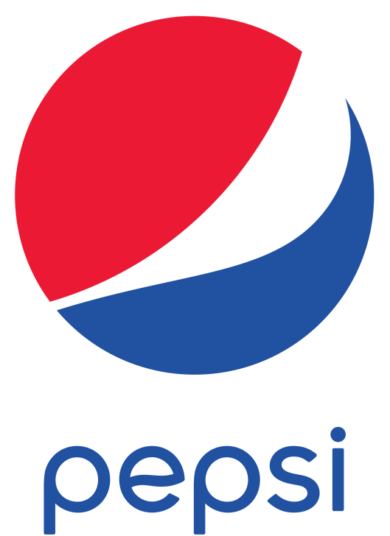
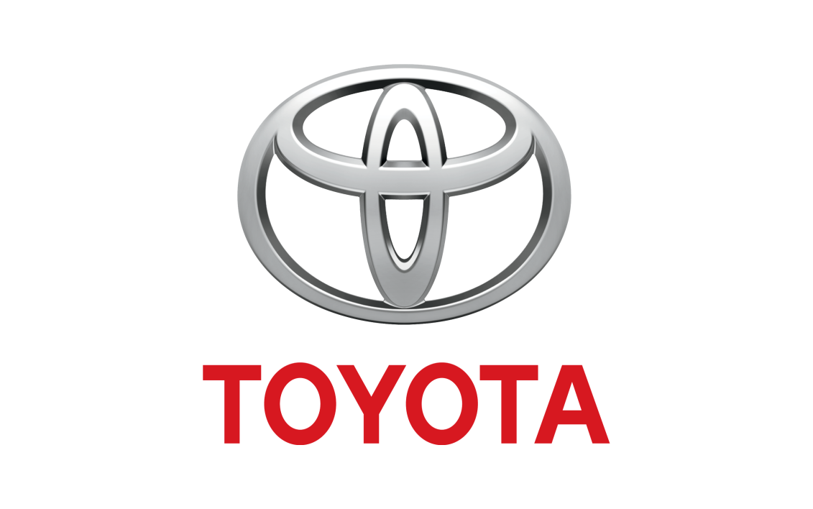

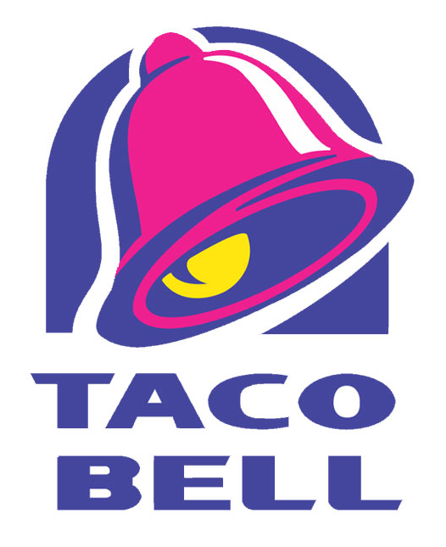

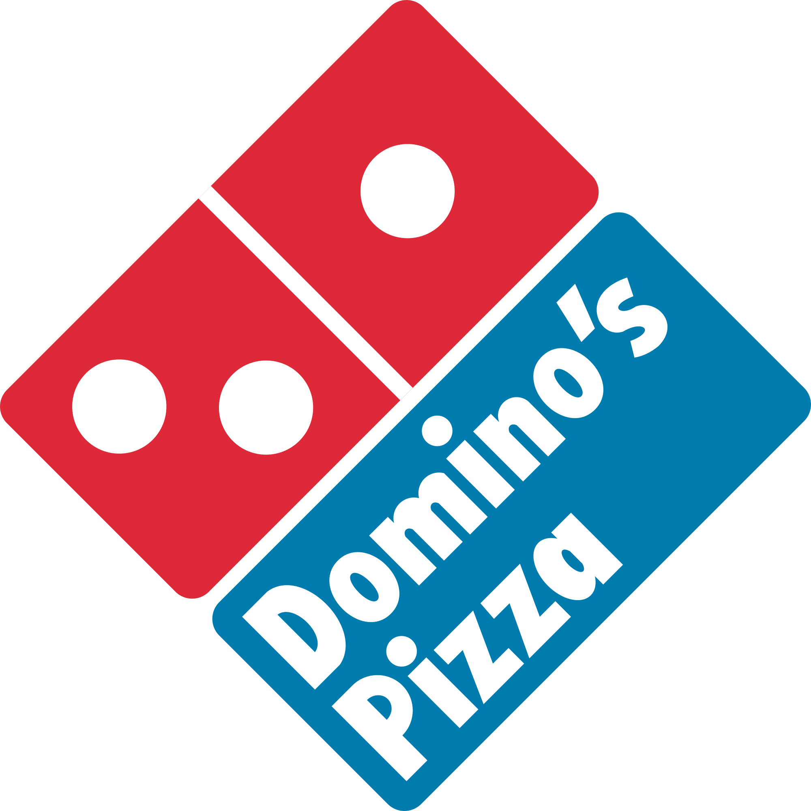

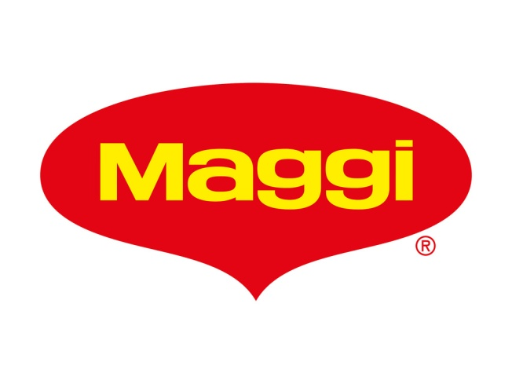
Brand Crisis (Managed)

Slide 15
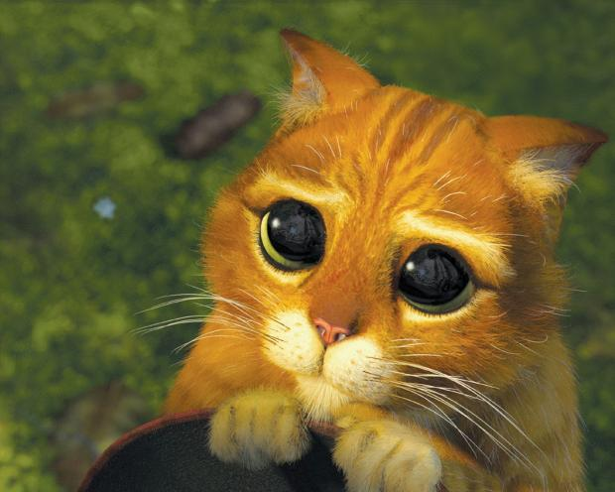
Management of Brand Crisis
Crisis Management Plan
Crisis Management Team
Sort Things on Social Media
Public Relations Campaign
Media Relations
Recall the Product, if faulty
Apologize and Compensate the affected customers
Consultants

Slide 16
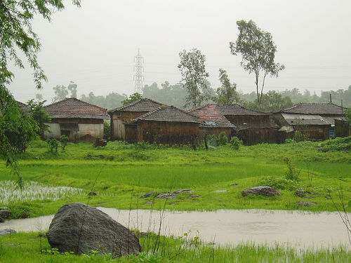
Special Purpose Advertising
1. Rural Advertising
Advertising and marketing in town and village areas.
Through sources like print media, televsion, radio, theatre, local mela, demonstration, announcement, participation and explanation, etc.
Use of both media
- Traditional Media
Puppetry, dance and drama, word of mouth, accouncements, processions, events, demonstration, posters, wall paintings, vehicle covering, audio vans, etc.
- Mass Media
Television, newspapers, radio, cinema halls, point of purchase, digital media, etc.

Slide 17
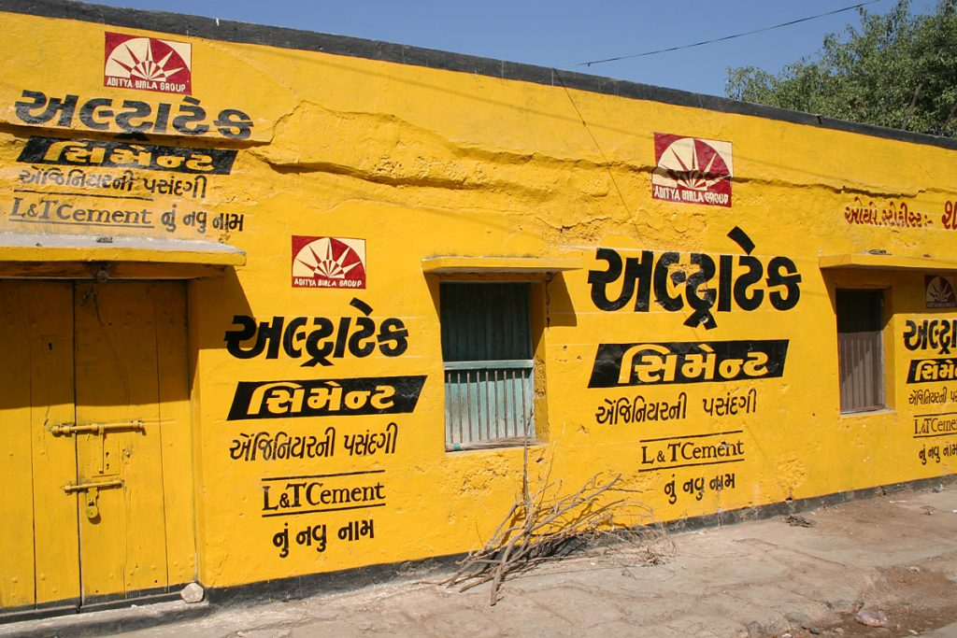

Slide 18
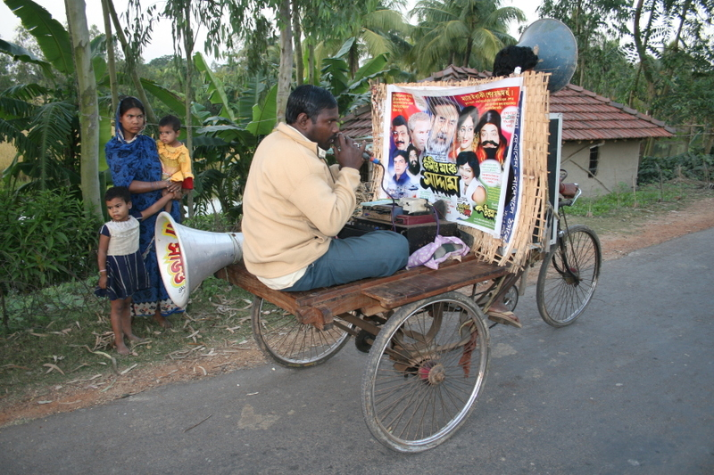

Slide 19
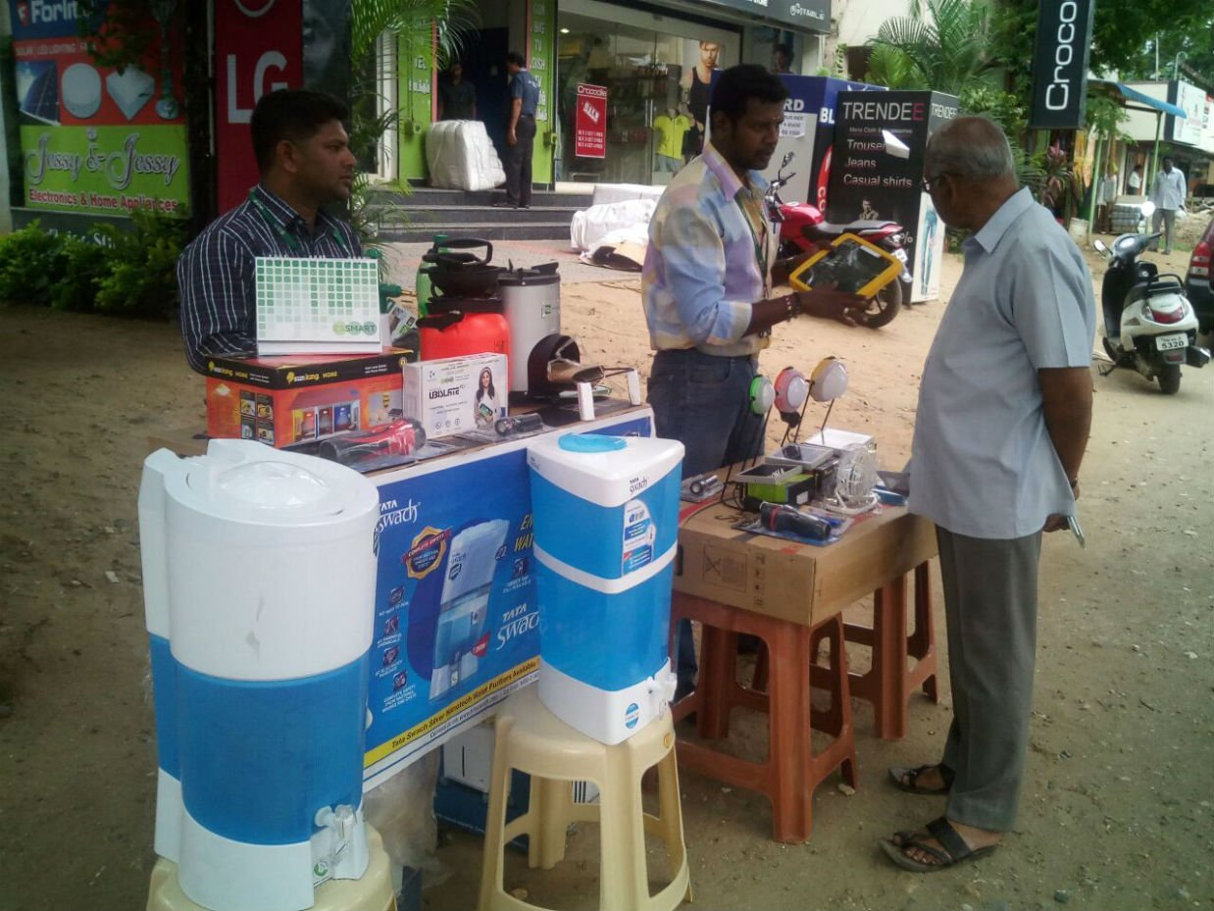

Slide 20
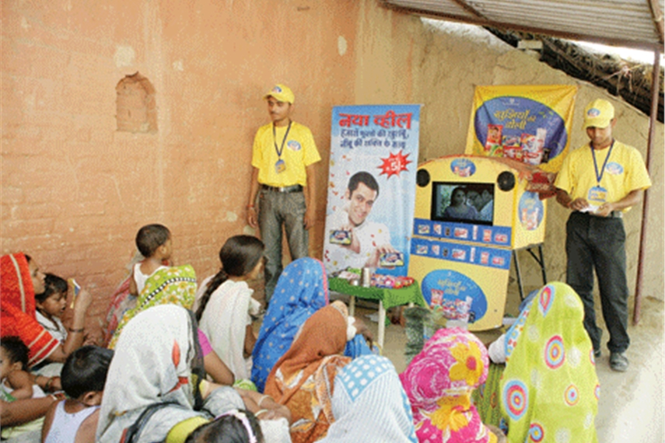

Slide 21
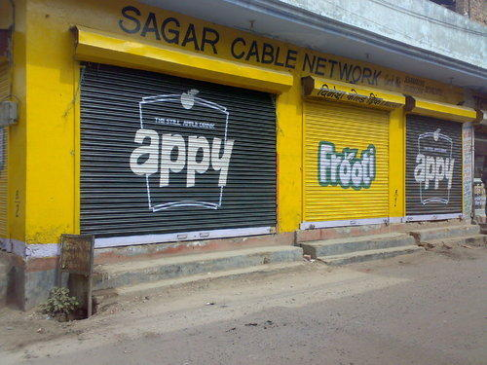
Rural Advertising Strategies
Influencer Strategy - Promotion is done through a user. Could be a reknowned person in the rural market, for eg. a trader, priest, teacher, Sarpanch, landlords, religious leaders, Babas, etc.
Participatory Strategy - Promotion is done by organizing events or gatherings and available audience are made to participate in the show/campaign. (Kaan Khajura Tation)
Show-N-Tell Strategy - A strategy to educate villagers about brands and product utility. Can be a social message or product or service.
Product Demonstration Strategy - Live demonstration is shown to the gathering so as to create product and brand awareness.

Slide 22
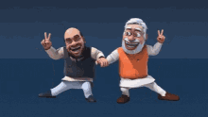
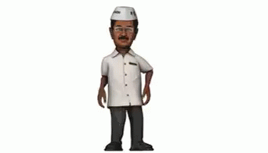
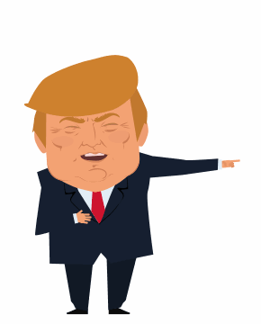

2. Political Advertising
Advertising by political parties for crating party awareness before elections.
Showcase of achievements in economy, health, education, industry, etc.
Dessimination of infrastructural development information.
Special schemes by the Government.
Public appeal/invitation/wishes for organising cultural events, sports, birthday celebration, condolence, etc.
Main mdia used is television, newspapers, radio, posters, banners, hoardings, internet, sms, etc.

Slide 23
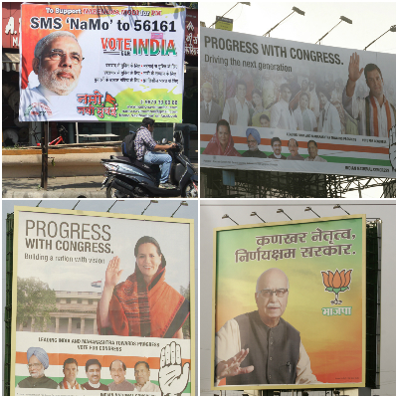

Slide 24
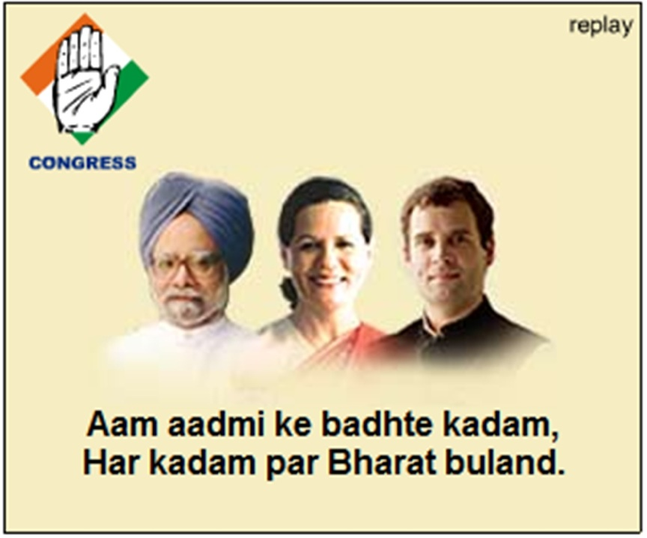
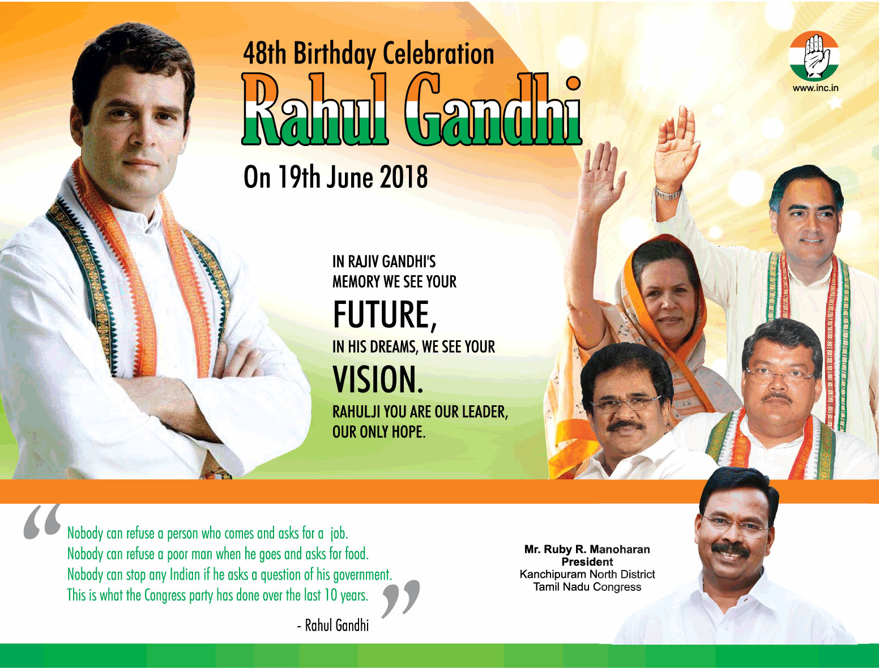
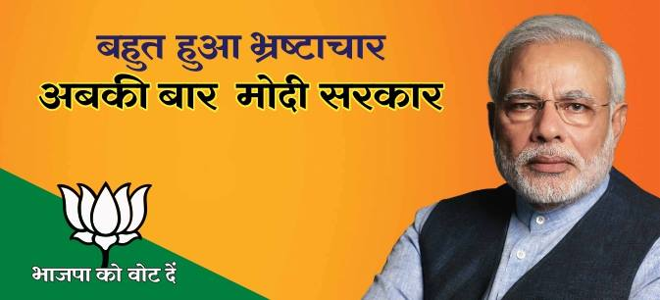

Slide 25

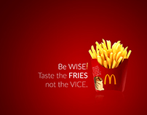
3. Advocacy Advertising
A kind of corporate image advertising, but in an aggressive style.
A way to correct market's negative attitude.
Generally argumentative or controvertial.
Basically done to counter unfavourable reporting with respect to product, service, employees, stakeholders, romours, etc.
Mainly, mass media is used like television, newspapers where detailed information can be dessiminated.

Slide 26
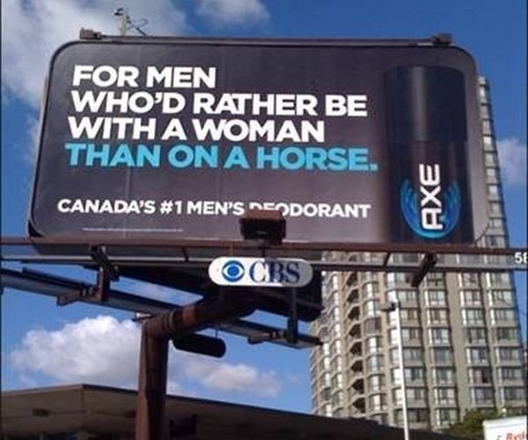
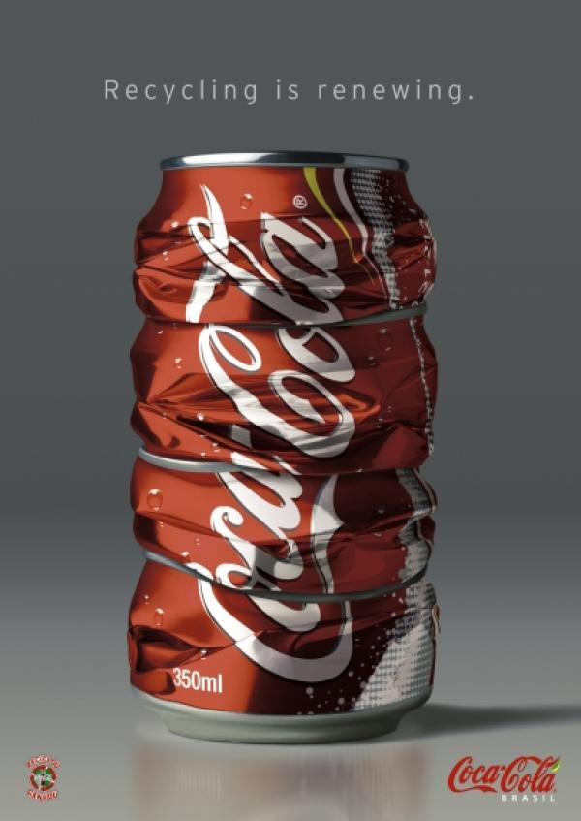

Slide 27

4. Corporate Image Advertising
Institutional/Organizational advertising.
Basically to build, improve, maintain a good image of the company in the minds of people.
Products and services are not targeted. Rather, the corporate is.
Companies with large economies of scale go for such advertising.
Such ads include research and development, manufacturing units, no. of employees, foreign collaborations, supply chain, market position, recognition, list of products and services offered, social responsibility steps taken, etc.

Slide 28


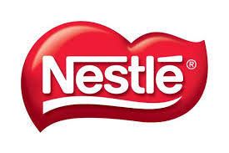
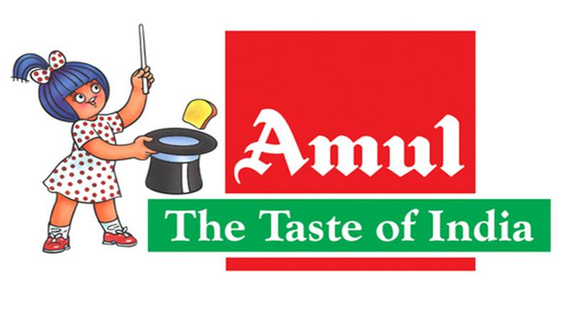


Slide 29

5. Green Advertising
A part of Green Marketing
A promotion technique where environmental concerns are raised by the business organisations.
Environmental friendly products are marketed, as a USP, thereby building greenwashing.
An advertisement showing the “naturalness” in the product.

Slide 30
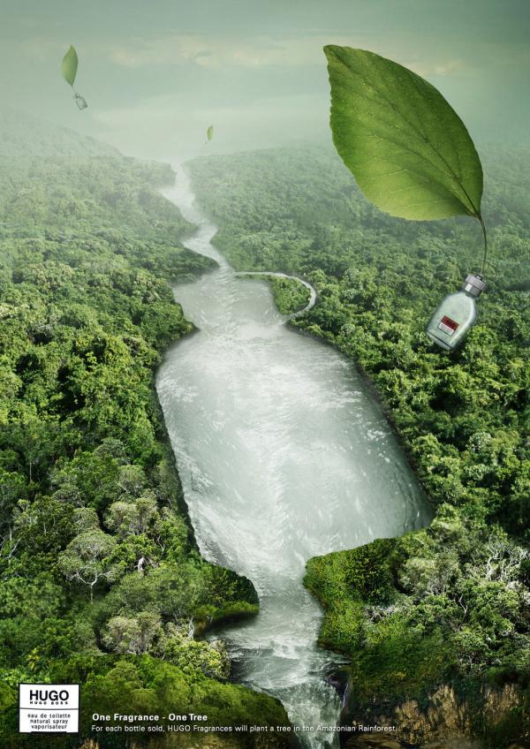
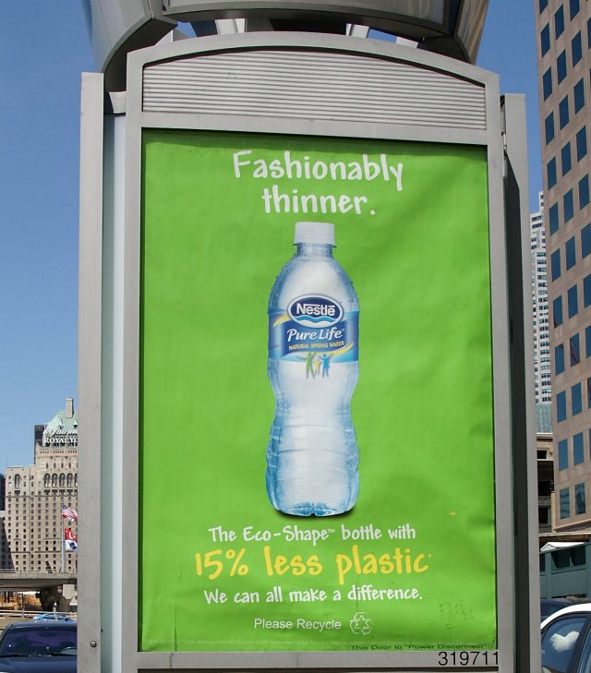


Slide 31
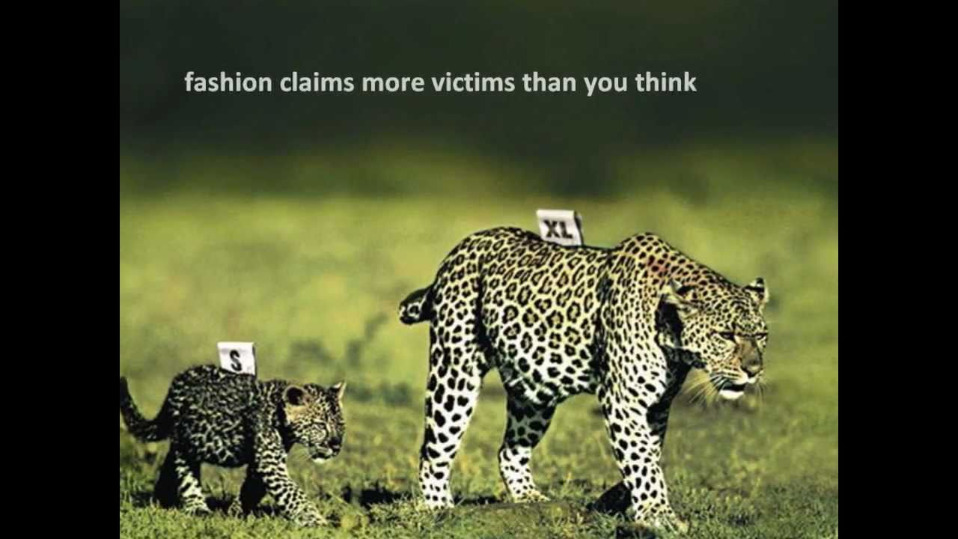

Slide 32
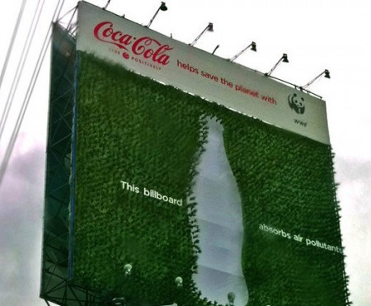

Slide 33
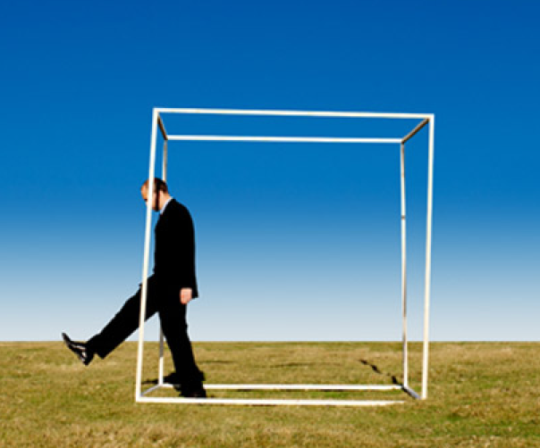
An advertisement strategy concept designed for businesses to promote their products or services in an unconventional way with little budget to spend.
Involves high energy and imagination focusing on grasping the attention of the public at a more personal and memorable level.
Can be a Guerrilla warfare if the marketing strategy adopted by the challenger firm is intended to launch an intermittent attack with an intention to demoralize the competitor.
Guerilla Advertising

Slide 34
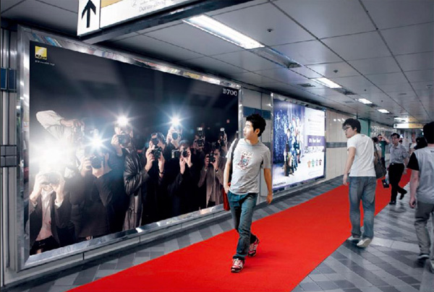

Slide 35
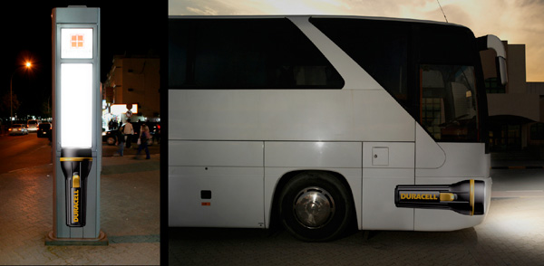

Slide 36
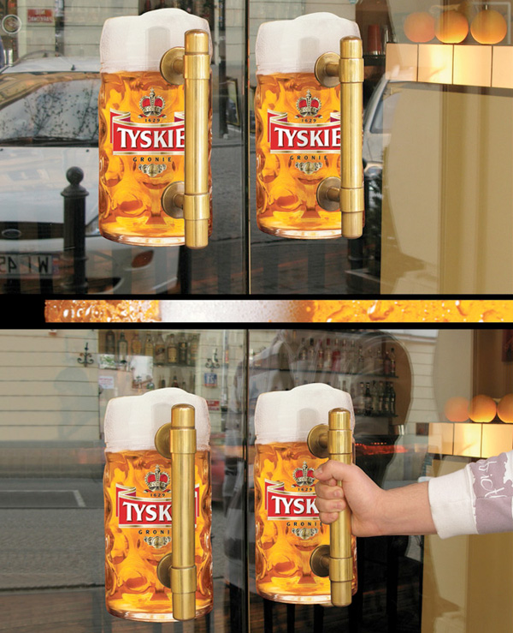

Slide 37
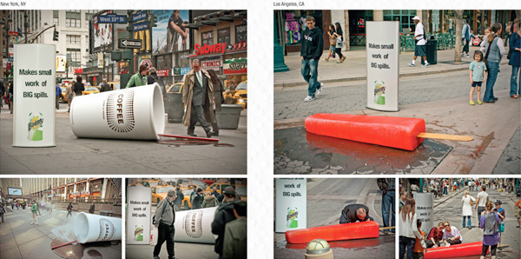

Slide 38

Recent Trends in Advertising Media
Media Convergence (television – internet – outdoor)
Interactivity (immediate response - internet – outdoor campaigns)
Use of Modern Media
(Social Media)
Tracking of Audience
New Media Options (App based – web based – packaging based)
Media Convergence (television – internet – outdoor)

Slide 39
ADVERTISING EXECUTIONAL STYLES
Slice-of-Life: Depicts people in normal settings, such as at the dinner table or in their car. McDonald's often uses slice-of-life styles showing youngsters munching French fries and Happy Meals on family outings.
LIFESTYLE: Shows how well the product will fit in with the consumer's lifestyle. Eg. Maruti Suzuki Family Cars, Bajaj Automobiles, Vivo Mobile Selfie Expert.
Spokesperson Testimonial : Can feature a celebrity, company official, or typical consumer making a Testimonial or endorsing a product or service. Akshay Kumar endorses Road Safety and meeting traffic rules for Mumbai Traffic Police.

Slide 40
FANTASY: Creates a fantasy for the viewer built around use of the product. Carmakers often use this style to let viewers fantasize about how they would feel to be speeding around tight corners or down long country roads in their cars.
Real or animated: Creates a character that represents the product in advertisements, such as the Chota Bheem for Dabur.
Product Symbols: Mc Donald, Starbucks, Google, Adidas, Shell, etc.
MOOD: Builds a mood or image around the product, such as peace, love or beauty.
IMAGE: Tanishq ads showing wearing of diamond rings and diamond necklaces portray passion and intimacy while extolling that a "diamond is forever.“ Raymonds for genuine “luxury suiting”.

Slide 41
DEMONSTRATION TECHNIQUE: Laundry detergent ads are famous for demonstrating how their product will clean clothes and make them whiter and brighter. Eg. Tide, Surf Excel, Henko.
MUSICAL: Conveys the message of the advertisement through song. Eg. “Hero Moto Corp – Hum me hai Hero”, “Ponds – Google Woogly Woosh”, Closeup – Kya aap close up karte hain….”
SCIENTIFIC: Uses research or scientific evidence to give a brand superiority over competitors. Eg. Horlicks, Dettol Handwash, Lifebuoy Soap.

Slide 42


